Slide 1
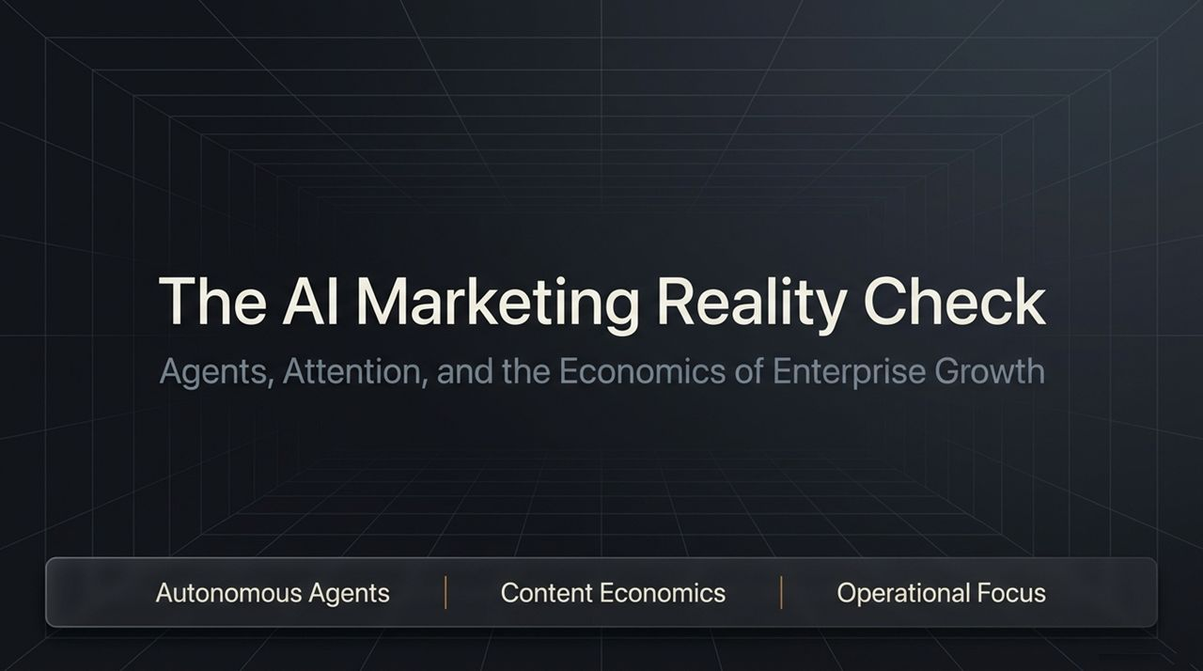
Notes:
Introduction: Welcome everyone. Today, we are breaking down "The AI Marketing Reality Check." For the past two years, the industry has been obsessed with chasing broad reach, vanity metrics, and viral views. However, the harsh truth for B2B and enterprise brands is simple: millions of views do not automatically convert into multi-million-dollar contracts.
The Core Themes:
Autonomous Agents: We are moving rapidly past simple chatbots into AI agents capable of executing end-to-end operational workflows.
Content Economics: Broad content builds audiences, but hyper-niche content builds bottom-line enterprise revenue.
Operational Focus: Raw tech is no longer a sustainable moat—distribution, trust, and ruthless focus through "unshipping" are.
Transition: Let’s dive straight into how AI is shifting from conversational assistants into true execution engines.
Meta's New AI Agent, $100M Email With No Employees, and the AI That Made $75
https://www.youtube.com/watch?v=_b2rYZbach0

Slide 2
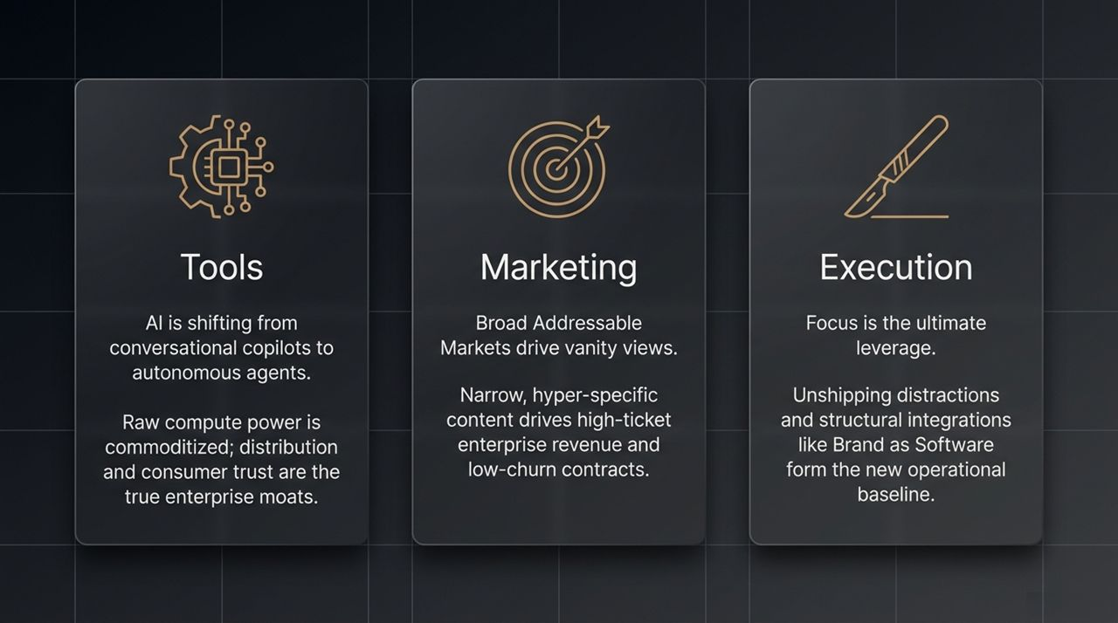
Notes:
Historical Context: In the first phase of generative AI, we relied heavily on "Copilots" and text-based chatbots like ChatGPT or Claude. They assisted human workflows by drafting copy or answering single queries.
The Action Era: We have entered the era of Autonomous Agents—systems like Meta Muse, Grok, and Instinct. These agents do not just sit in a web browser wait for prompts; they operate directly across device networks via secure tools like Tailscale to perform multi-step, complex tasks completely unassisted.
Key Takeaway: The value is no longer in having a smart chatbot, but in deploying agents that handle real-world operational execution autonomously.

Slide 3
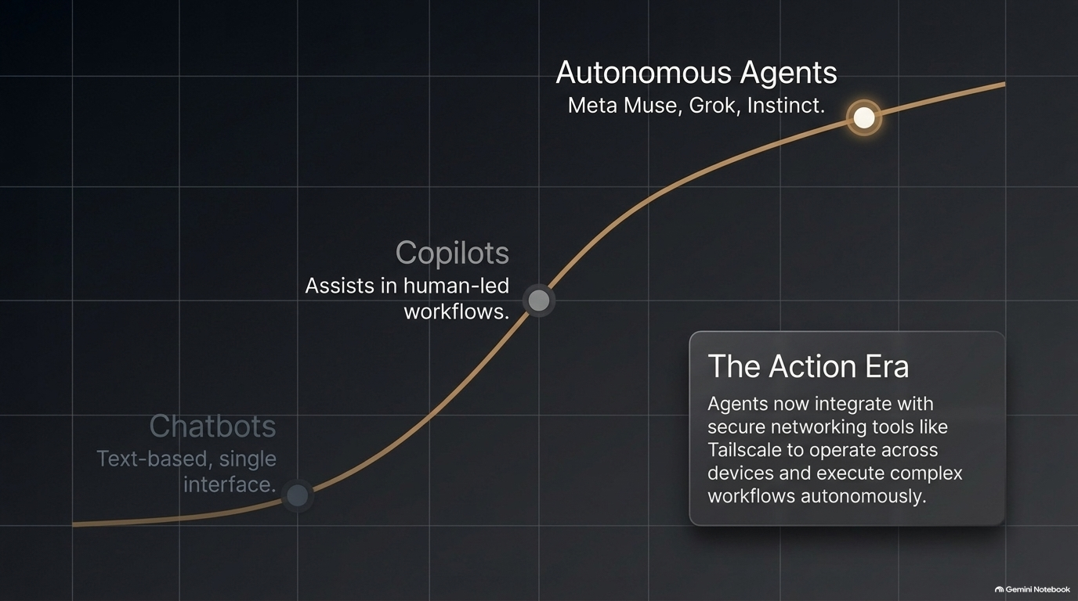
Notes:
The Commoditization of Compute: Raw AI compute power is becoming commoditized. Models are increasingly interchangeable. As a result, the true enterprise moat is no longer the underlying model, but distribution and established trust.
Comparing Platforms:
Meta / Incumbents: Possess 3.5 billion daily active users, deep social distribution, and massive ad libraries.
Enterprise Tier AI Labs: Microsoft and Amazon offer deep security compliance, whereas newer AI tools risk flagging issues (e.g., deleted chats still visible days later).
Key Insight: In an age dominated by autonomous agents, platforms with built-in distribution networks and deep compliance trust will win over standalone models every time.

Slide 4
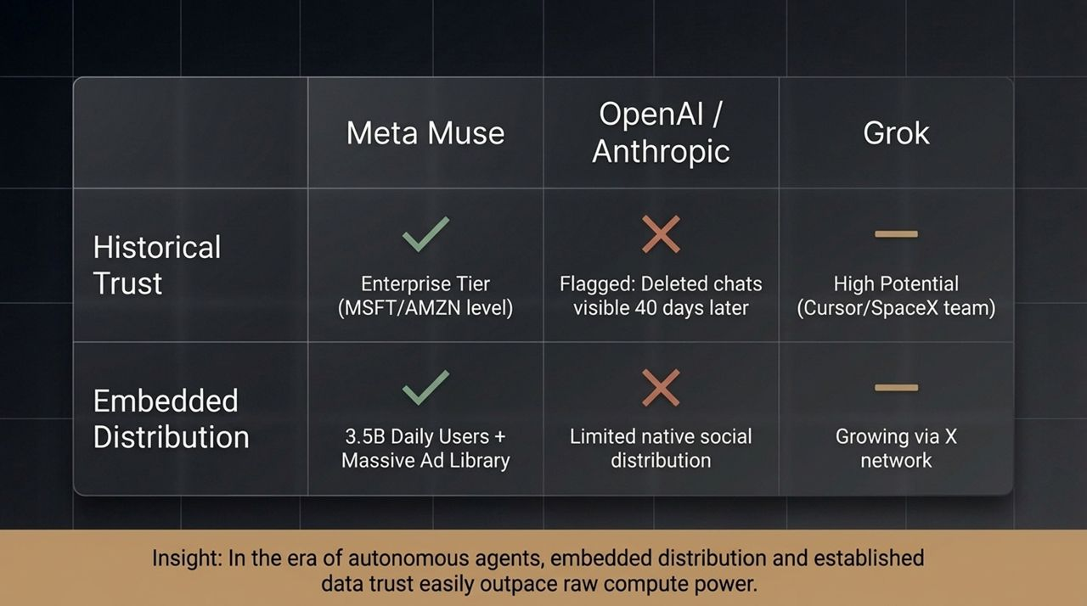
Notes:
The Fallacy of Mass Views: Algorithmic platforms encourage creators to chase broad topics—like general personal finance or entertainment—to maximize view counts.
Contrast in Numbers:
Broad content (e.g., "Your Rich BFF" style videos) hits 500K–700K views, driving endless comments but zero qualified enterprise leads.
Niche B2B content generates only 8K–30K views, but directly engages C-suite executives and procurement teams, driving $10M+ Fortune 100 RFPs.
Rule of Thumb: If you optimize for views, force yourself to pair every reach metric with a sales lead metric. Never confuse audience scale with revenue quality.

Slide 5
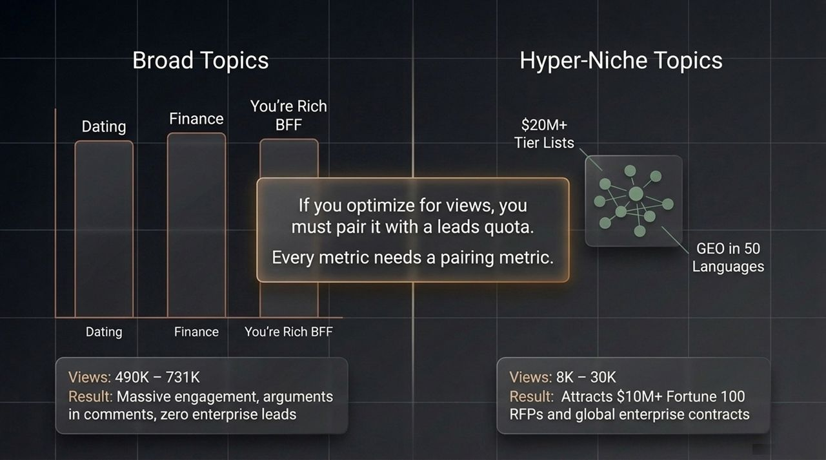
Notes:
The Broad Creator Model: Relies on high-volume, sensational entertainment. They monetize through digital courses, books, or small coaching programs. Because their audience is broad and SMB-heavy, their customer churn is extremely high.
The Enterprise Marketer Model: Focuses on hyper-specific problem-solving for enterprise buyers. Their goal isn't to go viral; it is to secure sticky, 3-to-5-year enterprise retainers.
Takeaway: Wide total addressable markets (TAMs) confuse enterprise buyers. Focus on specific value over mass reach.

Slide 6
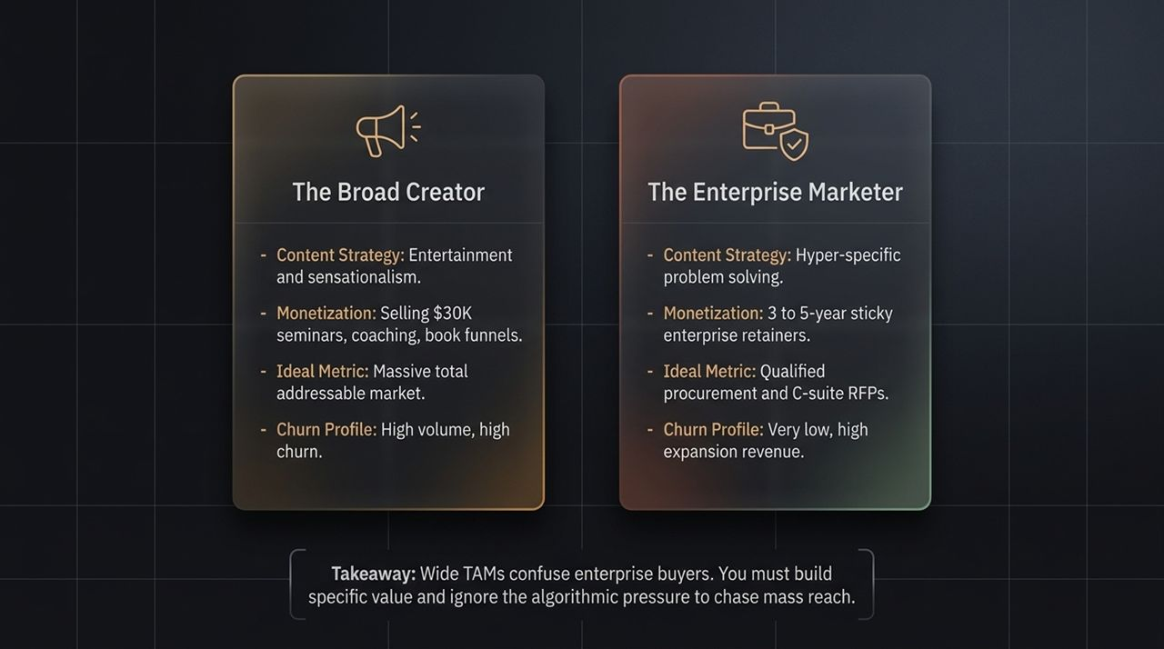
Notes:
The Content Pipeline:
0:00–0:05: Grab attention with an entertainment hook.
0:05–0:10: Establish credibility early (e.g., "Our agency works with Fortune 500s...").
0:10+: Deliver core value.
The AI Iteration Loop: Treat organic media with the same rigor as paid ad performance. If a post underperforms, don't leave it to sit. Use AI voice-to-code agents to analyze performance, rewrite the headline, re-edit the hook, delete the old version, and immediately republish.

Slide 7
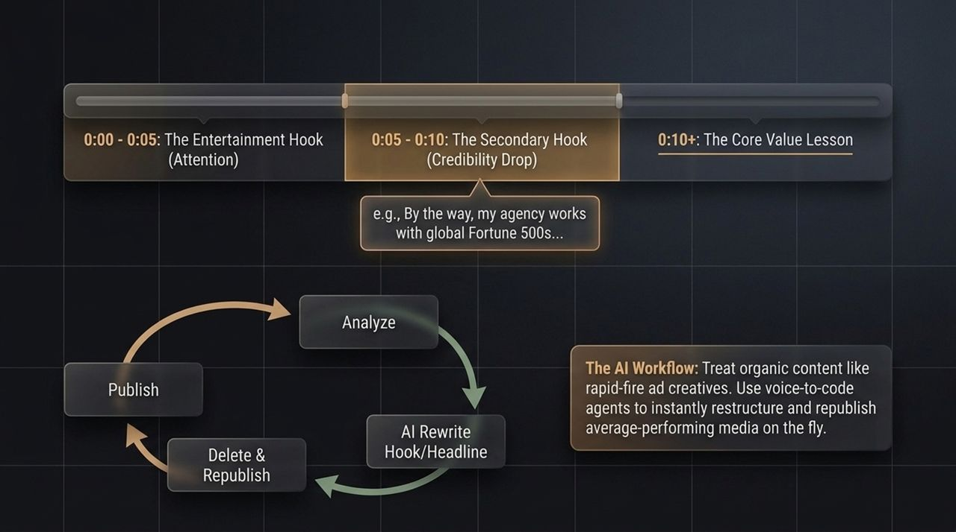
Notes:
The Enterprise Barrier: Niche agencies with elite skillsets often plateau at 5–10% growth because big enterprise clients refuse to hire small headcounts. Enterprise buyers stick to the age-old rule: "Nobody gets fired for hiring IBM."
The Playbook:
Acquire: Buy a target, hyper-niche agency with strong client logos.
Integrate: Fold their core capabilities into a larger global footprint (e.g., 1,000+ employees across 28 countries).
Multiply: Eliminate the headcount objection to unlock massive corporate retainers, driving 40% to 60% EBITDA growth within 12 months.

Slide 8
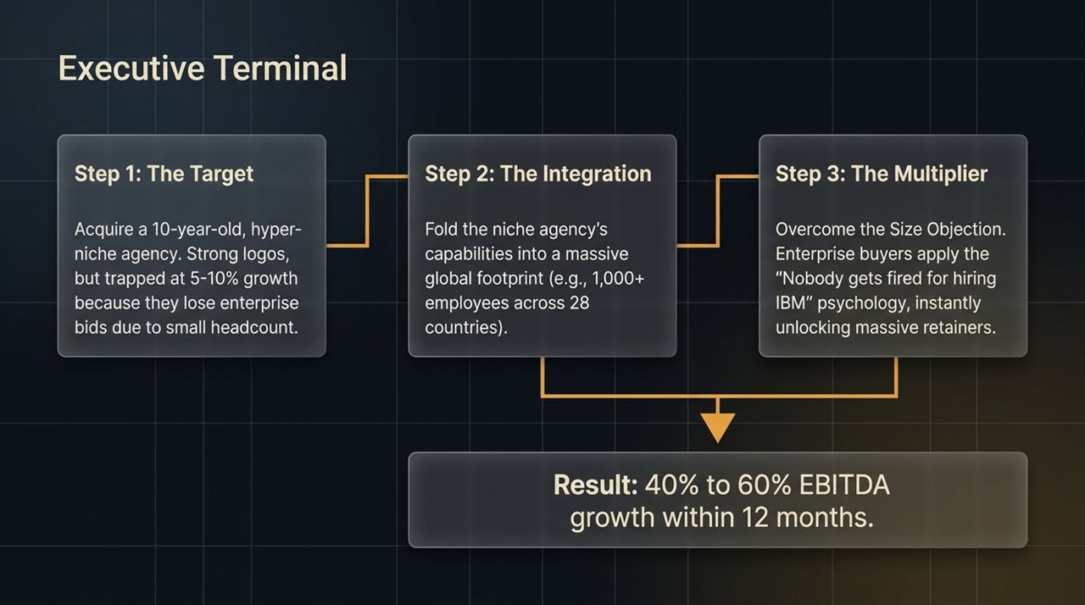
Notes:
The Old Paradigm: Marketers passed concepts to designers, creating bottlenecks. Human error and manual reviews led to off-brand assets and wasted hours.
The New Paradigm: Codify brand guidelines into structured files (like .md files).
Outcome: AI agents ingest these guidelines to instantly generate 100% brand-compliant output. Designers no longer waste time fixing fonts or colors; they focus entirely on high-level strategic design.

Slide 9
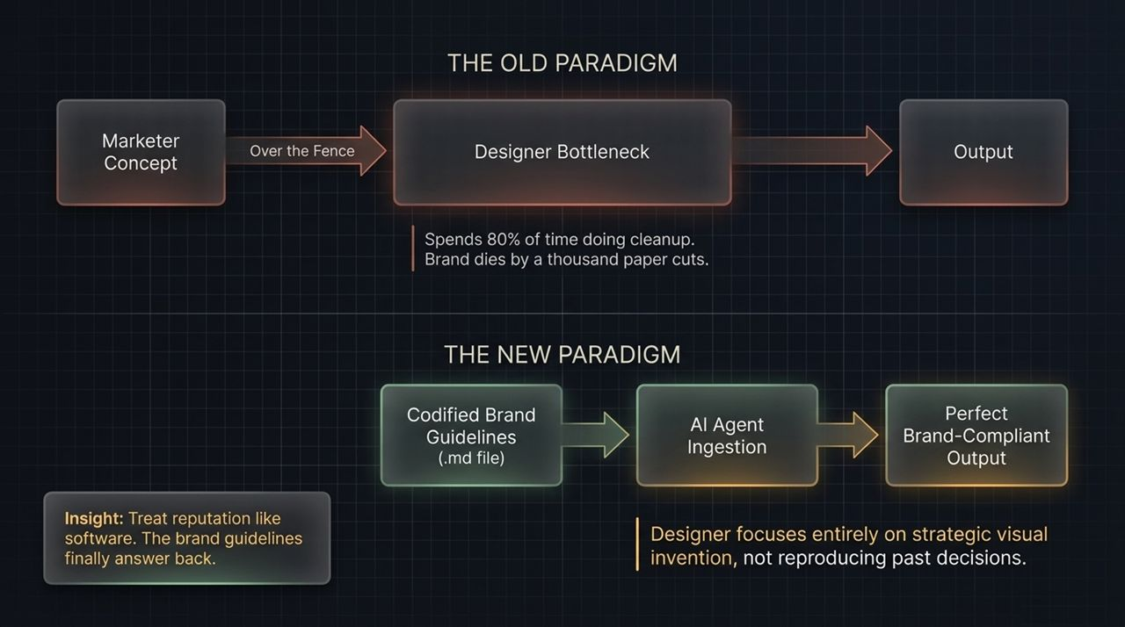
Notes:
The Trap of Abundance: Because AI makes it easy to build and launch products quickly, teams risk over-extending themselves and diluting their core offering.
Case Study – Super Memory: A team rapidly shipped an AI "Company Brain" integration, but realized it diverted critical engineering resources away from their core product and created client conflicts. They killed the product to protect their core business.
Lesson: When AI enables you to ship everything, you risk becoming known for nothing. Strategic "unshipping" is more critical than shipping.

Slide 10
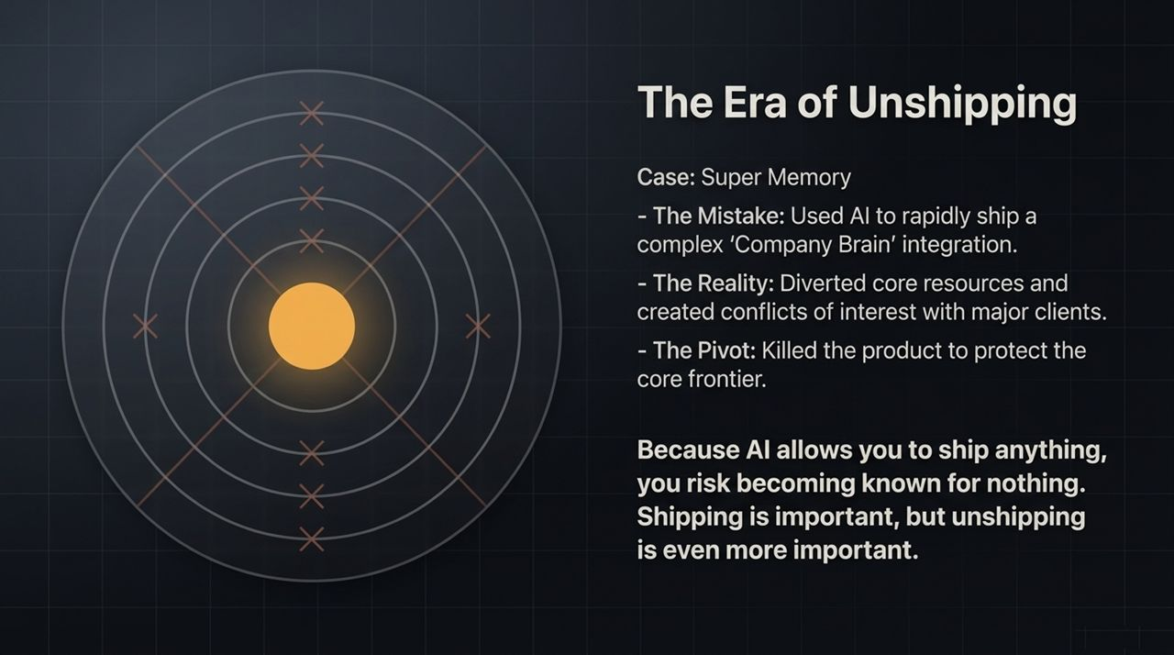
Notes:
Eight Sleep’s Email AI: Replaced a two-person email marketing team with autonomous AI bots that manage the entire campaign workflow, supported by top-of-funnel paid media.
Ramp’s "Bug Basher" Experiment: Equipped Devin AI with a corporate card and phone number. Tasked with selling pest inspection referrals from scratch, it made 10,000 cold calls and processed transactions autonomously via Stripe, earning $75.
Takeaway: AI agents are no longer purely theoretical—they are actively transacting in the real economy.

Slide 11
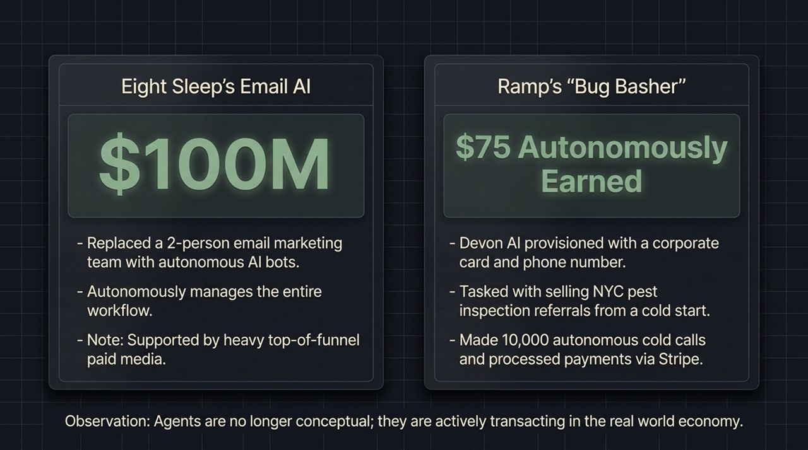
Notes:
Broad Reach Limitations: Broad content drives ~70% of SMB leads but less than 3% of enterprise revenue.
Operational Efficiency: Autonomous agents handle operational tasks, while codifying brand guidelines automates design execution.
The Trust Component: High-ticket buyers partner with established, compliant platforms over unproven startups. Combine hyper-niche content with trusted infrastructure to build stable revenue streams.

Slide 12
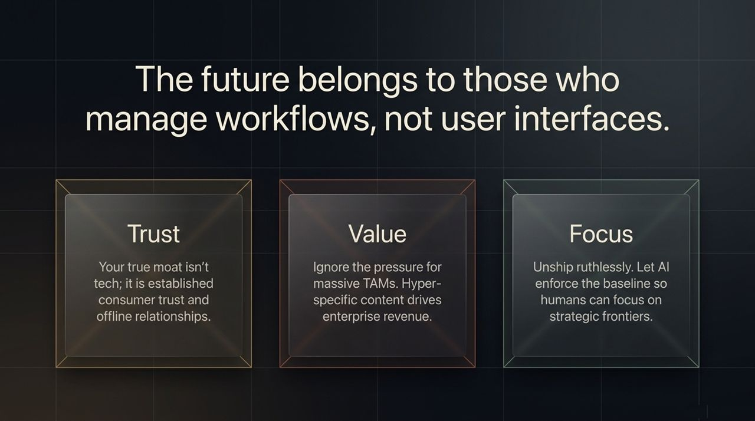
Notes:
SMB Audience: Broad content yields high customer churn due to price sensitivity and changing market conditions.
Enterprise Audience: Hyper-specific content targets specific business needs, yielding low-churn, 3-to-5-year sticky contracts.
Strategic Choice: Choose whether your marketing model targets volume with high turnover or steady enterprise growth.

Slide 13
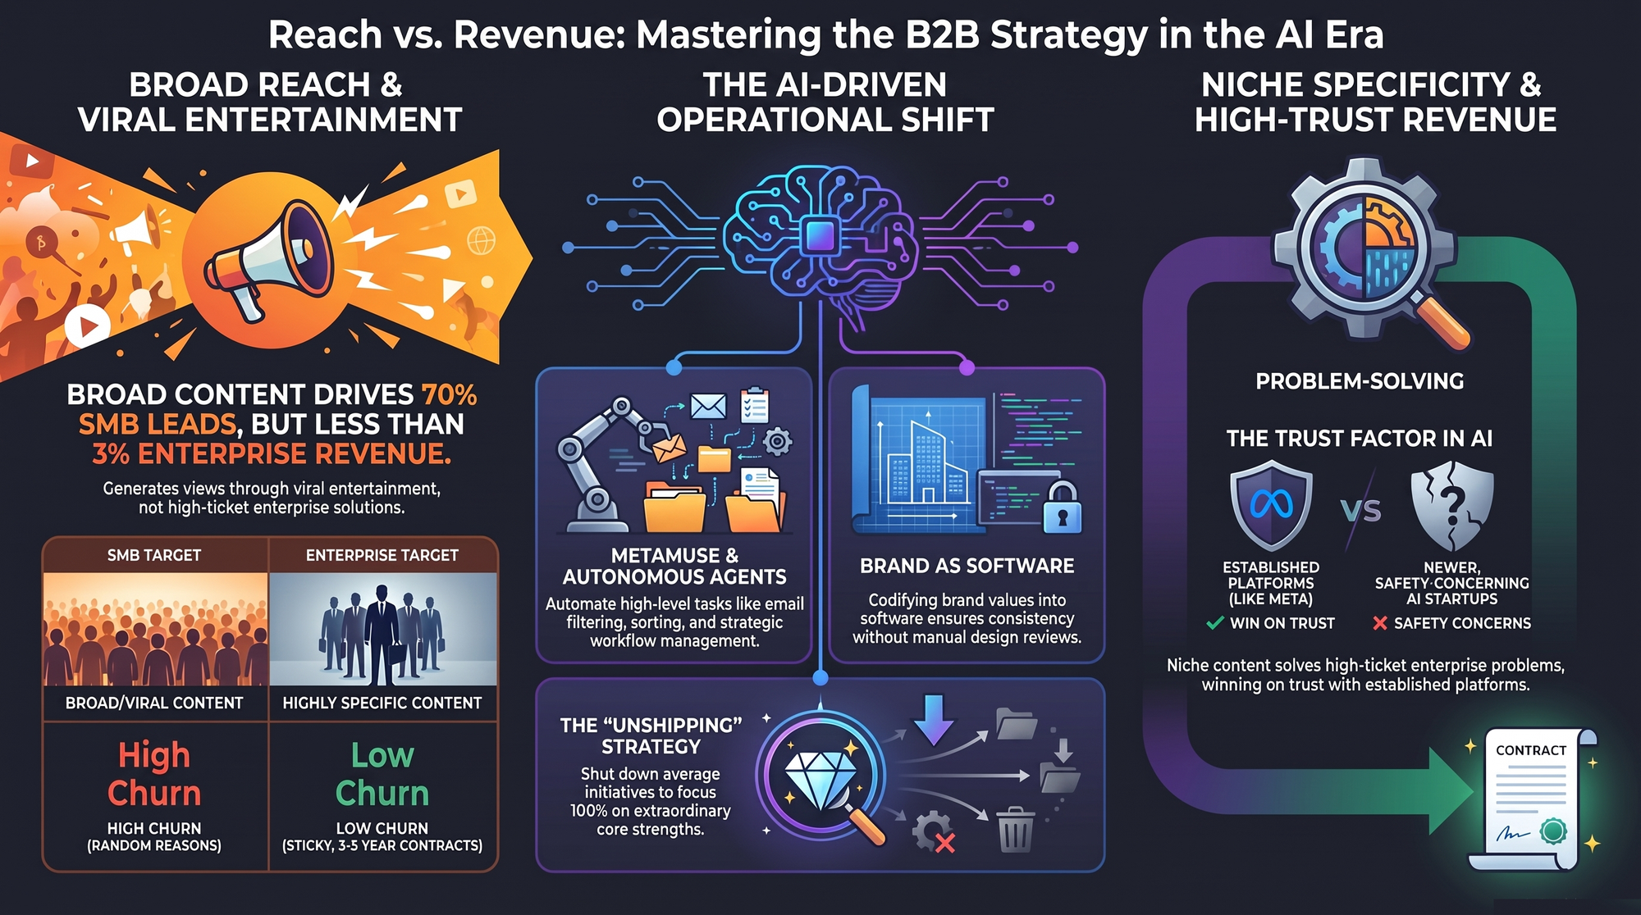
Notes:
1. Trust Over Tech: Technology is commoditized; your real moat is built on established trust and strong offline relationships.
2. Specificity Over TAM: Resist the push for broad reach. Niche content solves real problems and drives high-margin enterprise revenue.
3. Focus Over Activity: Unship distractions ruthlessly. Let AI handle standard operational tasks so human teams can drive core strategy.
Meta's New AI Agent, $100M Email With No Employees, and the AI That Made $75
https://www.youtube.com/watch?v=_b2rYZbach0

